Slide 1


Slide 2
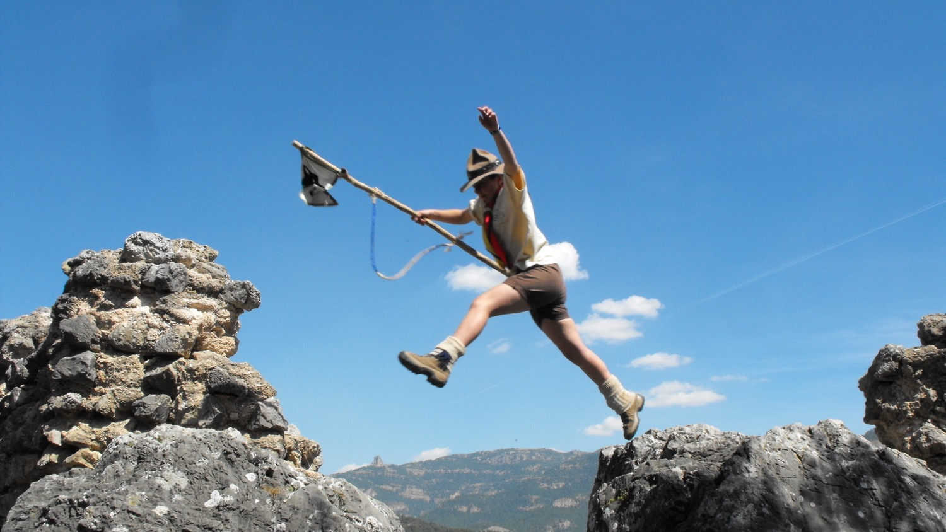

World Scouting’s
Vision 2023
Strategy for Scouting

Slide 3
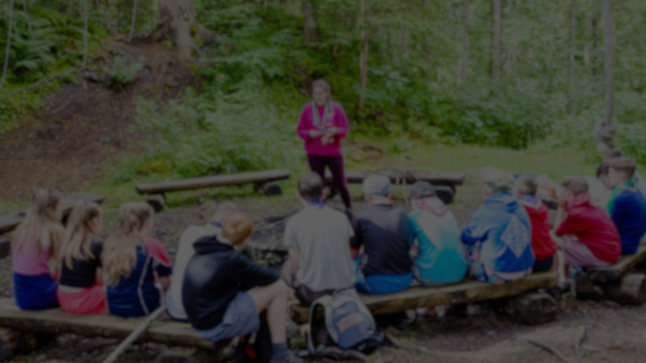
Vision?
Strategic planning?
Mission?
Strategic goals, objectives, …?
Notes:
First I’m going to explain to you a bit about what “a strategy” is
There are many words being used in this area and many different interpretations, depending on the handbook or expert you ask
I am going to explain you how WOSM uses the key elements in strategic planning. There might be other schools of thought, but I just want for the presentation that we speak the same language

Slide 4



Notes:
So, strategic plannig is actually pretty simple. I’ll explain it to you in a way that you will never forget anymore ☺
Let’s say that our organisation (WOSM in our case) is a spaceship
So strategic planning is about how you develop, improve your spaceship (organisation) into a much nicer, more powerful, bigger and colourful spaceship

Slide 5

Notes:
So where do spaceships fly?
In space of course – the universe

Slide 6

Where do we want to fly? Our purpose
On what fuel do we fly? Our business
How do we manage our spaceship? Our values
The known universe
= The society in which Scouting exists
(Currently earth)
Notes:
Our WOSM “universe” is limited to earth.
At the moment we don’t have any Scouting on the Moon or Saturn (yet).
Now although WOSM is active all across the planet, what we exactly do is limited – we do not build cars, we do not produce medicine and we don’t sell smartphones for example.
The mission of an organisation defines the reason why it exists:
A mission contains 3 elements: purpose – business – values

Slide 7
Scouting’s Mission
The known universe
= The society in which Scouting exists
(Currently earth)

Slide 8
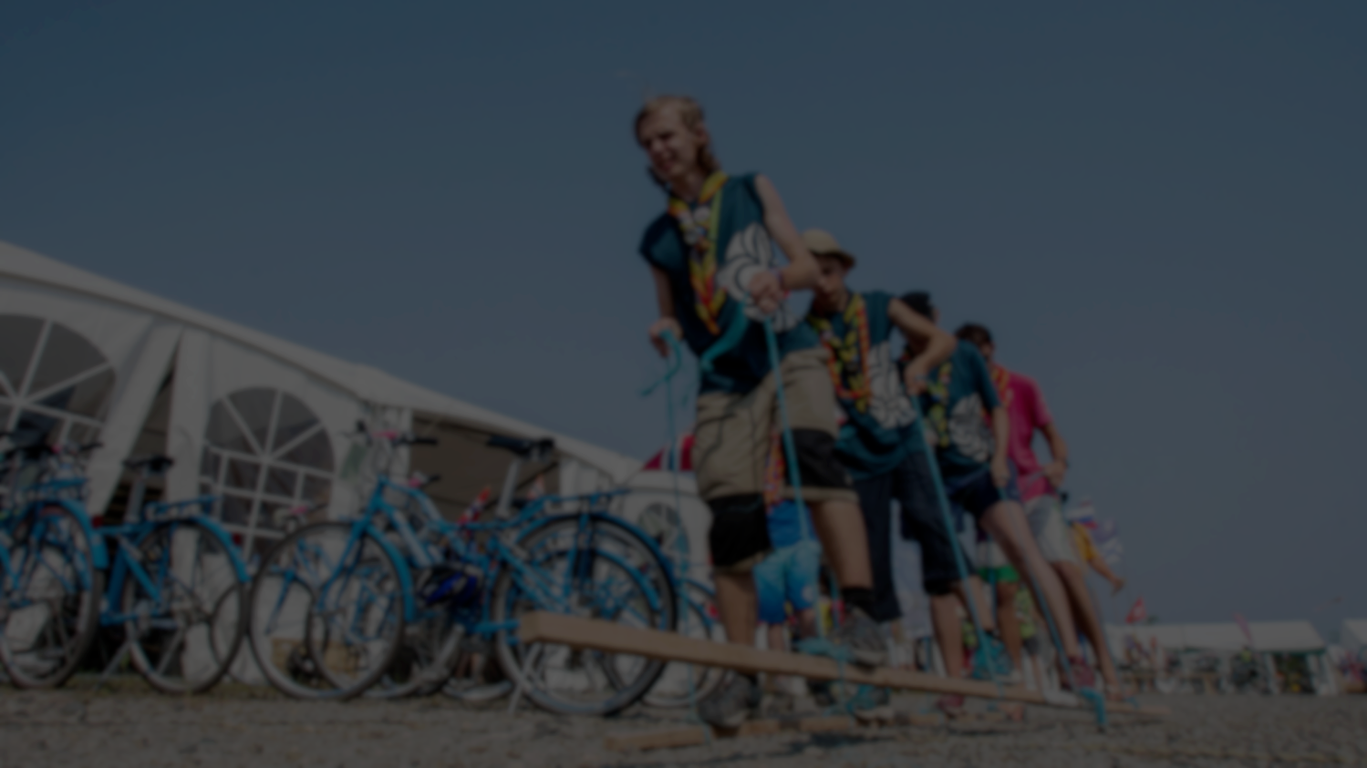
Scouting’s Mission
Purpose
Business
Values
Creating a
Better World
Impact
Community
& Society
Education
Young People
Active Citizen
Scout Promise
Scout Law
Notes:
(let the audience try and guess what WOSM’s purpose, business and values are). The slides show them one by one to help you with your little quiz.

Slide 9
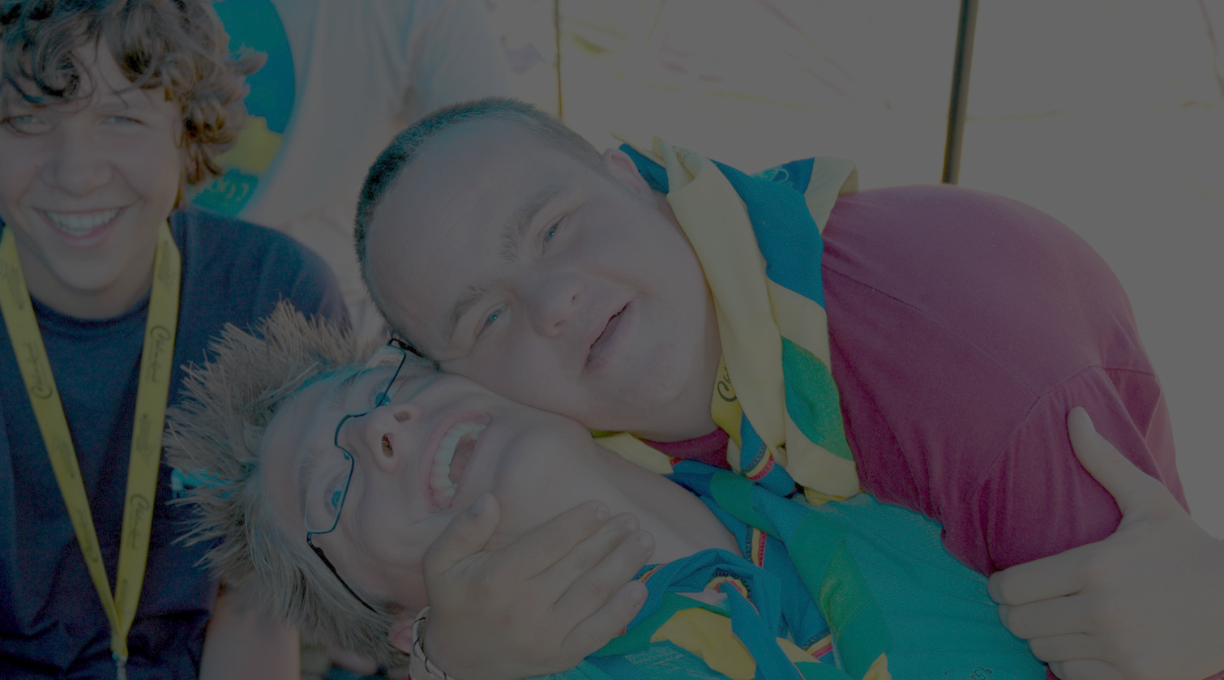
”To contribute to the education of young people, through a value system based on the Scout Promise and Law, to help build a better world where people are self-fulfilled as individuals and play a constructive role in society."
Mission
What is our purpose?
What is our core business?
What are our values?

Slide 10


Improved spaceship
other location
= WOSM’s vision 2023
The known universe
= The society in which WOSM exists
(Currently earth)
Planned flight path
= WOSM’s Strategy for Scouting
Spaceship= WOSM today
Notes:
So. Now we know where our spaceship flies on earth, and where not.
Now you can of course fly very slowly, only in specific parts, or you might want to fly very powerful all over the world being seen by many many people
So the spaceship is currently where we are today: 40 million members, 162 countries, our current youth programme, how we are currently perceived, etc.
But we could be much better, much more improved, reaching many more people
That’s a Vision – your long term aspiration, dream where you want to be.
For WOSM this is Vision 2023 - It was developed by the World Scout Committee in collaboration with all Regional Committees in 2013 and approved at the World Scout Conference WOSM in 2014 by all NSOs.
The “road” our “flight path” from our current situation to our vision is called a “strategy”, or in WOSM terms “the Strategy for Scouting”

Slide 11

"By 2023
Scouting will be the world’s leading educational youth movement,
enabling 100 million young people
to be active citizens creating positive change in their communities and in the world
based on shared values."
Vision for Scouting
2023

Slide 12
"By 2023
Scouting will be the world’s leading educational youth movement,
enabling 100 million young people
to be active citizens creating positive change in their communities and in the world
based on shared values."
Vision for Scouting
2023
Notes:
The horizon by which we aim our ambitions to be fulfilled:
2023, 3 triennia after Slovenia 2014
Our ambition to be the leading, most influential youth movement worldwide
Our quantifiable ambition to grow significantly over this period
The ultimate impact of the education we provide (cfr. Mission Statement) on a grass-roots level
Reminds us that everything Scouting does is based on shared values which unite us around the world

Slide 13









The known universe
= The society in which WOSM exists
(Currently earth)
6 Strategic Priorities to achieve
Vision 2023
Notes:
So, now you know what our dream is. Let’s talk a bit more about how we are going to get there
As you can see there are many different possible flight paths
Some however might not be the best way to go – we could crash into a meteor, have to do a detour to avoid another planet, etc…
So we defined 6 strategic priorities, waypoints you can say, which define in what we want to invest to make sure we reach our dream

Slide 14
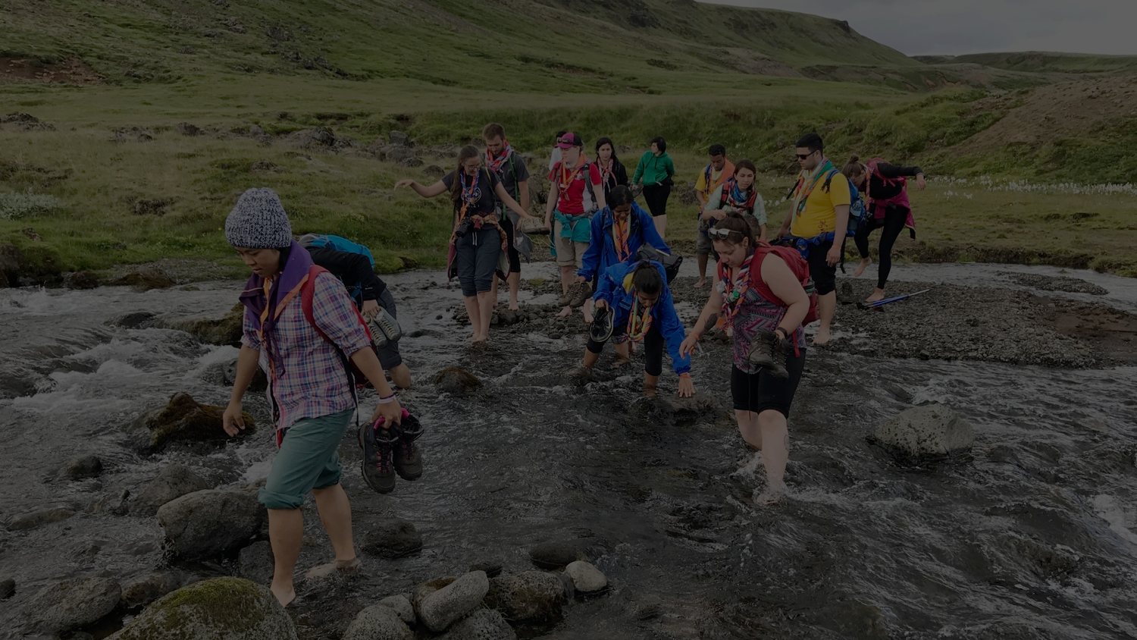






6 Strategic Priorities
Youth Engagement
Educational Methods
Diversity & Inclusion
Social Impact
Communications & Relations
Governance
Notes:
Here they are. You can find more info on each of them on www.scout.org/mission

Slide 15
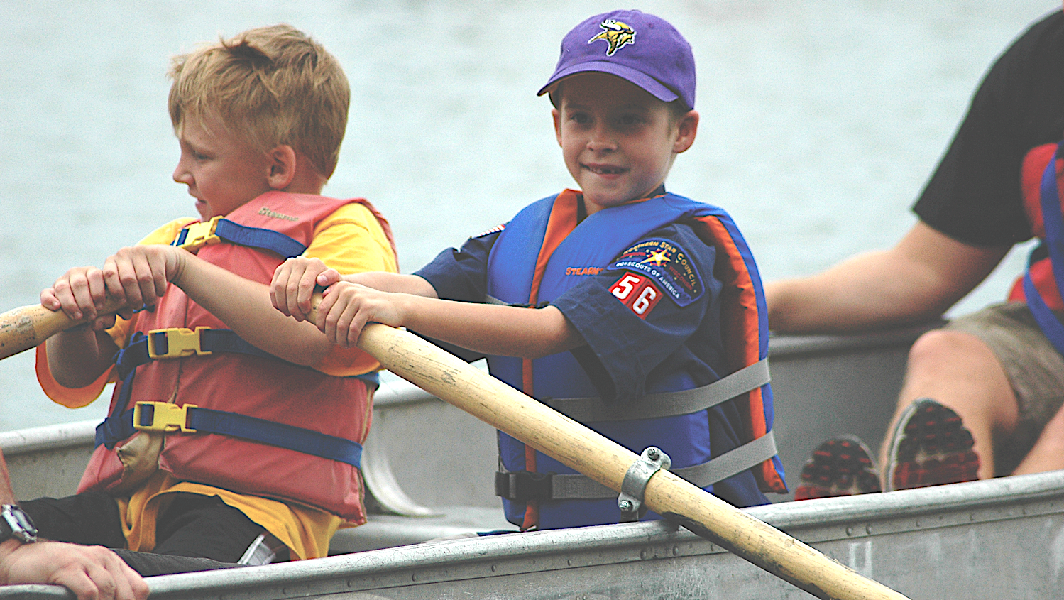
Triennium 1:
2014-2017
Triennium 2:
2017-2020
Triennium 3:
2020-2023
VISION 2023
Notes:
So there are 3 triennia between now and when we want Vision 2023 to be reality.

Slide 16
The known universe
= The society in which WOSM exists
(Currently earth)
1 Global and 6 Regional Strategies to achieve Vision 2023
Notes:
So, now you know what our dream is. Let’s talk a bit more about how we are going to get there
As you can see there are many different possible flight paths
Some however might not be the best way to go – we could crash into a meteor, have to do a detour to avoid another planet, etc…
So we defined 6 strategic priorities, waypoints you can say, which define in what we want to invest to make sure we reach our dream

Slide 17
Notes:
So, if somebody ever asks you what strategy is all about
Remember
It’s all about spaceships and how you make them bigger and better ☺

Slide 18
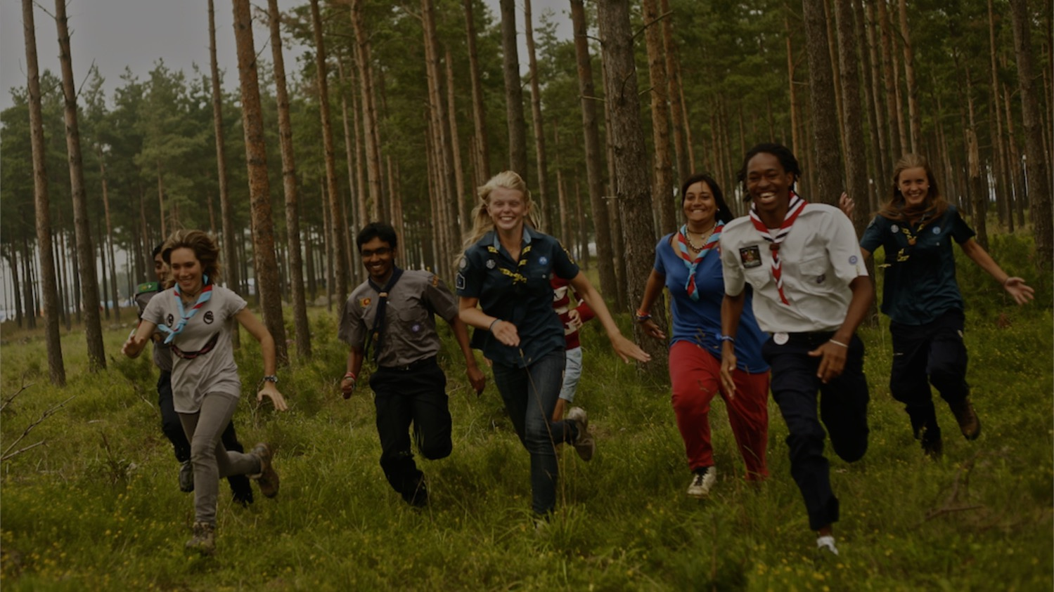
Thank You

